Slide 1
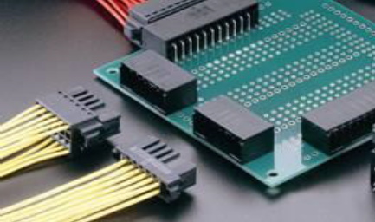
Dynamic–New generation connector
The Dynamic family is a broad new generation of connector products that can be used to transmit small current in signal loops as well as large current in power loops.
Product features:
• The product is designed for signal interface and power loop for
industrial automation
• For wire-to-panel applications
• 2-point contact box terminal, lock design with lock tone notification,
anti-misinsertion key, etc.
• Dual-row, multi-layer design, 2.00mm PIN pitch,
• load current 3A, Voltage up to 250V MAX
• Plating thickness up to 15 U "gold, fully account for performance and
cost
3

Slide 2
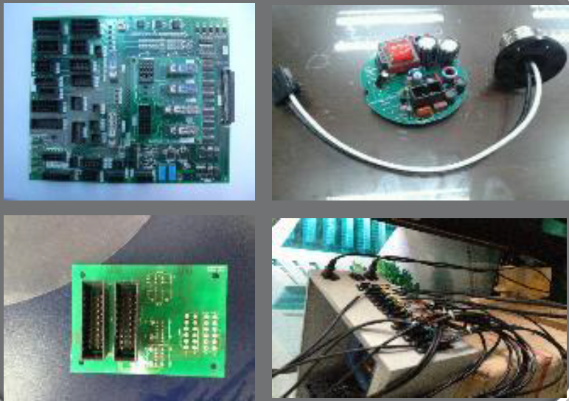
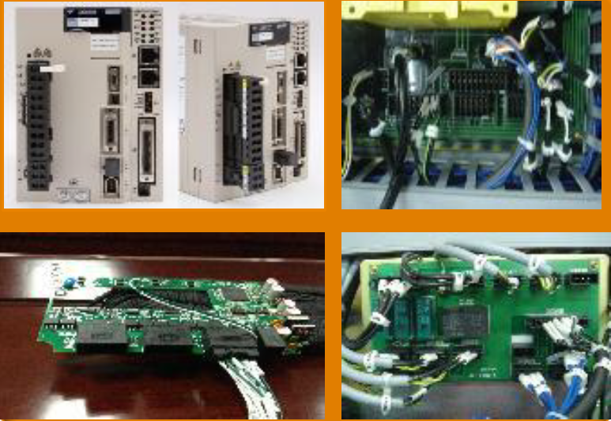
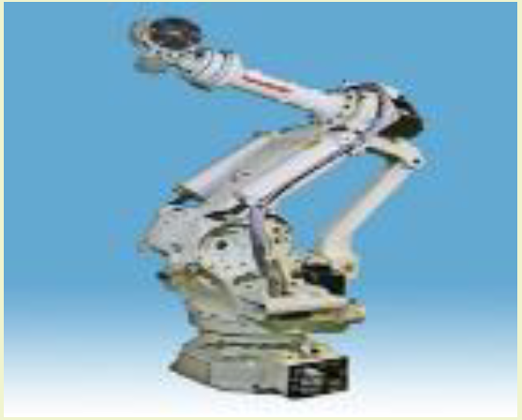
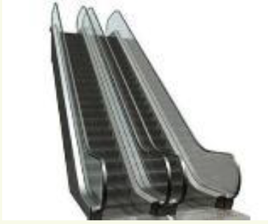
Industry And Application
Industrial automation & Controls：
√ Motion Control
√ Robot Control
√ Frequency converters
√ Electrical automation
√ Machine tools and equipment
√ Uninterruptible Power supply
√ Various power sources
√ Energy management
Commercial building & Railway：
√ Lighting control
√ Elevator and escalator control
√ Revolving door control
√ Subway screen door
√ Railway and subway air
conditioning control
√ Other traffic monitoring
Vibration environment reliable locking structure maintenance-free high density space saving
4

Slide 3
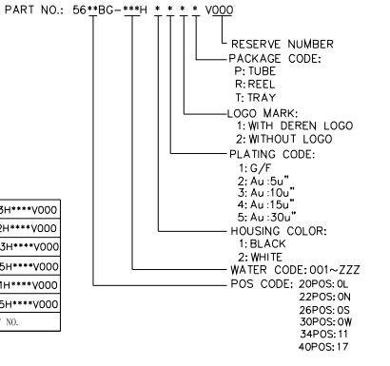
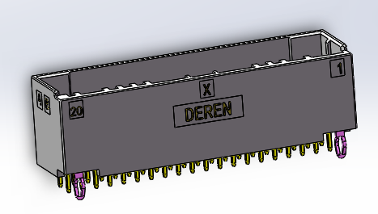
Industrial Connector Product List
WTB Male 180°Part Number Description:
WTB Male 180°
2

Slide 4
Industrial Connector Product List
Item | P/N | Description | Specification |  |  |  |  | Dimension
 |  |  | Pin Count | Pitch | SMT/ DIP | Center Height | On Board Height | L | W | H
1 | 5617BG-003H****V000 | WTB Male 40P 15H Pitch2.0 180°DIP Black Au15u" | 40 | 2 | DIP | N/A | 12.45 | 42.6 | 11.30 | 15.5
2 | 5611BG-002H****V000 | WTB Male 34P 15H Pitch2.0 180°DIP Black Au15u" | 34 | 2 | DIP | N/A | 12.45 | 36.6 | 11.30 | 15.5
3 | 560WBG-003H****V000 | WTB Male 30P 15H Pitch2.0 180°DIP Black Au15u" | 30 | 2 | DIP | N/A | 12.45 | 32.6 | 11.30 | 15.5
4 | 560SBG-005H****V000 | WTB Male 26P 15H Pitch2.0 180°DIP Black Au15u" | 26 | 2 | DIP | N/A | 12.45 | 28.6 | 11.30 | 15.5
5 | 560NBG-001H****V000 | WTB Male 22P 15H Pitch2.0 180°DIP Black Au15u" | 22 | 2 | DIP | N/A | 12.45 | 24.6 | 11.30 | 15.5
6 | 560LBG-005H****V000 | WTB Male 20P 15H Pitch2.0 180°DIP Black Au15u" | 20 | 2 | DIP | N/A | 12.45 | 22.6 | 11.30 | 15.5
2

